Slide 1

Daily Digital Diary with Date-Time and File Input​
A CAPSTONE PROJECT PRESENTATION ON
CSA 0851 PYTHON PROGRAMMING FOR HEALTHCARE
GUIDED BY:
Dr. G. AYYAPPAN
Dr. U. ARUL
PRESESNTED BY:
Devadharshini E-[192524483]
Magesh S-[192524002]

Slide 2


AGENDA
Literature Review
Introduction
Objectives
Module 1
Module 2
Advantages
Applications
Future Scope
Conclusion
References

Slide 3
LITERATURE REVEIW
S.No | Author & Year | Study Focus | Key Finding | Relevance to Project
1 | Shaffer et al., 2023 | Online Sleep Diaries | Proper system design & data management important | Supports structured digital diary system
2 | Basir et al., 2024 | Digital Recordkeeping | Digital records more accurate than paper | Justifies digital diary instead of manual diary
3 | Tiwari et al., 2025 | Date-Time Bugs in Python | Time handling errors are common | Shows importance of correct date-time logging
4 | Kamo et al., 2024 | Wearable Digital Diary | Reliable time-based data collection | Supports automatic timestamp feature
5 | Alcaire et al., 2024 | Digital Diary Apps | Real-time experience capture | Validates usefulness of diary application

Slide 4
INTRODUCTION
The Daily Digital Diary with Date-Time and File Input is a digital application designed to record daily activities in an organized and secure manner.
It replaces the traditional handwritten diary with a modern digital solution.
The system allows users to write daily entries, automatically captures the current date and time, and supports uploading files such as images and documents.
This makes daily record management more efficient, structured, and easily accessible.

Slide 5
OBJECTIVES
The main objective of this project is to develop a simple and user-friendly digital diary system.
It aims to enable users to write and store daily entries digitally.
The system automatically records date and time to maintain chronological order.
It also allows file attachments for better documentation.
Overall, the goal is to provide secure, organized, and efficient record management.

Slide 6
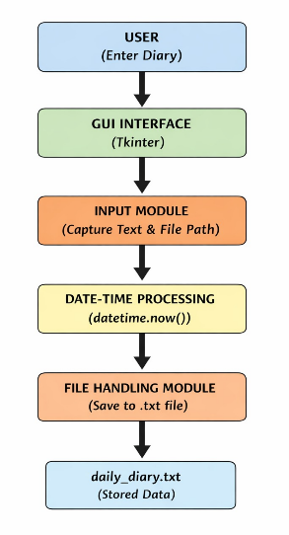
ARCHITECTURE DIAGRAM
The user enters the diary through a user-friendly GUI, the system securely captures the input, automatically records the current date and time, and stores the entry permanently in a text file for future reference.

Slide 7
MODULES OVERVIEW
The system is divided into two main modules: Module 1 – Input Interface and User Entry Capture Module 2 – File Handling and Date-Time Management
Each module performs specific functions to ensure smooth working of the system.

Slide 8
MODULE 1 – INPUT INTERFACE AND USER ENTRY CAPTURE
This module focuses on user interaction with the system.
It provides a simple interface where users can write their daily notes or activities.
The module ensures that the entered data is properly validated before saving.
Users can save, view, edit, or delete their entries.
This module plays a major role in capturing and managing user input efficiently.

Slide 9
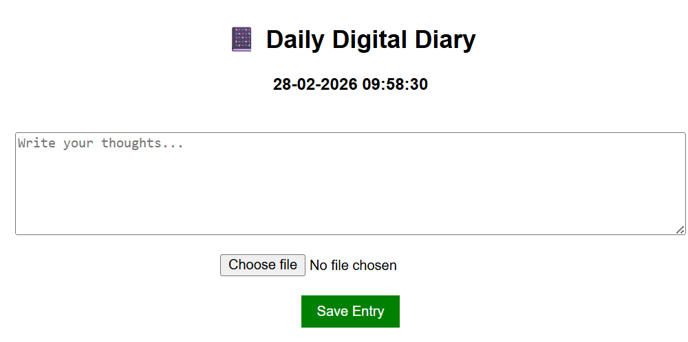
MODULE 1 OUTPUT

Slide 10
MODULE 2 – FILE HANDLING AND DATE-TIME MANAGEMENT
This module manages backend operations of the system.
Whenever a user saves an entry, the system automatically captures the current date and time.
This ensures that each entry is stored with a proper timestamp.
The module also allows users to upload files such as images, PDFs, or documents.
These files are stored securely and linked with the respective diary entry.
This helps in maintaining structured and organized records.

Slide 11
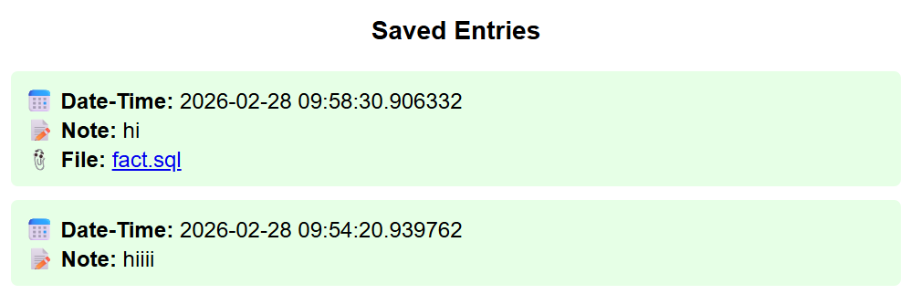
MODULE 2 OUTPUT

Slide 12
ADVANTAGES
The system reduces the use of paper and supports eco-friendly record keeping.
It provides automatic date and time tracking for better organization.
File attachment support makes documentation more complete.
Data is stored securely and can be accessed easily.
Overall, it improves efficiency compared to traditional diaries.

Slide 13
APPLICATIONS
This system can be used as a personal daily journal.
It can be used by students to record academic activities.
It is useful in offices for maintaining daily work logs.
It can also be used for project documentation and record keeping.

Slide 14
FUTURE SCOPE
In the future, the system can be enhanced by adding user login authentication.
Cloud storage integration can be implemented for remote access.
Search and filter options can be added for easy retrieval.
A mobile application version can also be developed.
Advanced features like reminders and AI-based analysis can be introduced.

Slide 15
CONCLUSION
The Daily Digital Diary with Date-Time and File Input is a simple yet effective digital record management system.
It ensures easy entry capture, automatic timestamp storage, and secure file management.
The system improves organization, accessibility, and efficiency. With further enhancements, it can be developed into a complete smart diary application.

Slide 16
REFERENCES
Shaffer, K.M., Daniel, K.E., Frederick, C., Buysse, D.J., Morin, C.M. and Ritterband, L.M., 2023. Online sleep diaries: considerations for system development and recommendations for data management. Sleep, 46(10), p.zsad199.
Basir, Md Samiul, Dennis Buckmaster, Ankita Raturi, and Yaguang Zhang. "From pen and paper to digital precision: a comprehensive review of on-farm recordkeeping." Precision Agriculture 25, no. 5 (2024): 2643-2682.
Tiwari, Shrey, Serena Chen, Alexander Joukov, Peter Vandervelde, Ao Li, and Rohan Padhye. "It’s about time: An empirical study of date and time bugs in open-source Python software." In 2025 IEEE/ACM 22nd International Conference on Mining Software Repositories (MSR), pp. 39-51. IEEE, 2025.
Kamo et al. (2024) developed a wearable-based 24-hour digital diary to monitor physiological and activity data in Parkinson’s patients, showing how digital diaries can reliably collect continuous time-indexed information.
Alcaire et al. (2024) examined how digital diary apps capture user experiences, focusing on app-based diary collection and the qualitative richness of digital entries.

Slide 17


